Slide 1
Optimizing through Data

Slide 2
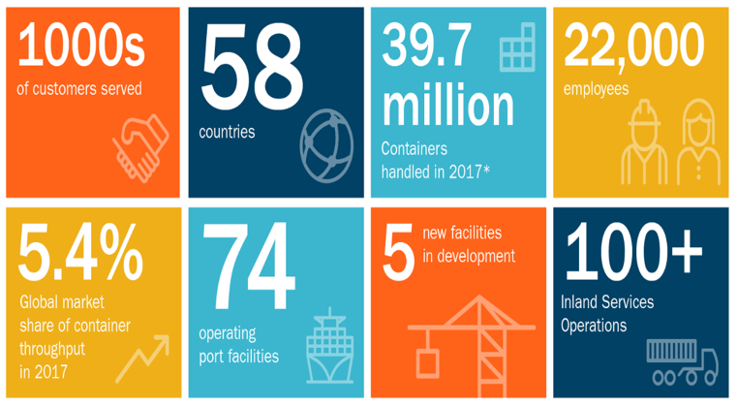
Logistics is generating millions of lines of data daily and we have only just begun to unlock I potential.

Slide 3
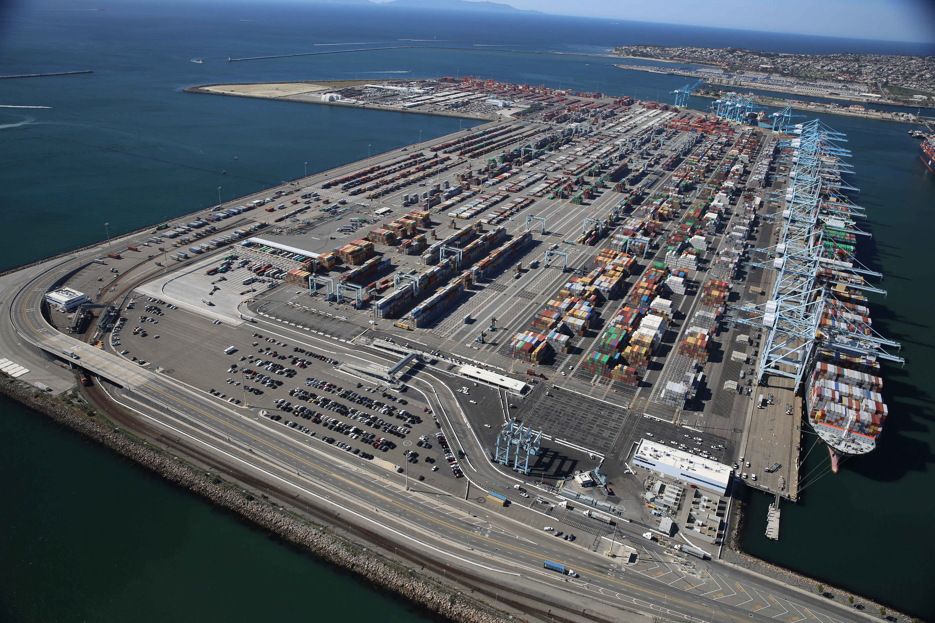


Slide 4
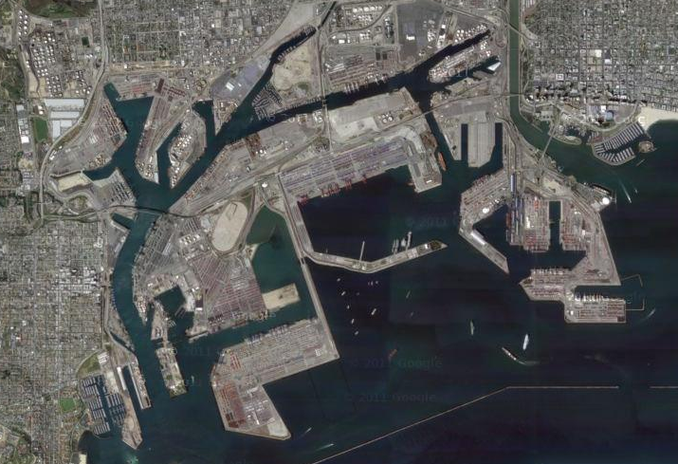

SML
Matson
MOL (ONE)
The Alliance
YML
The Alliance
MSC/HSUD/HYU/ML
2M Alliance
OOCL
Ocean Alliance
China COSCO
Shipping
Ocean Alliance
NYK (ONE)
The Alliance
K-Line (ONE)
The Alliance
Evergreen
Ocean Alliance
CMA-CGM/APL
Ocean Alliance
China COSCO Shipping
/ CMA CGM
Ocean Alliance
ML/HSUD/HYU/MSC
2M Alliance

Slide 5
Planning Overview
Marine Terminal

Slide 6
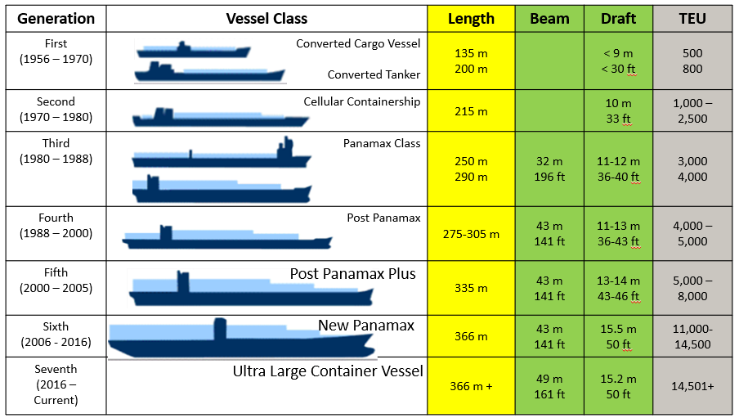

Slide 7

Terminal Challenges?
Capacity Constraints
Equipment/Operator Resources
Unequal workload – busy in the weekend
Frequent change of work environment
Seasonality Uncertainties
Very isolated in regards to Regional Planning

Slide 8
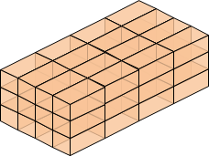
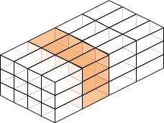
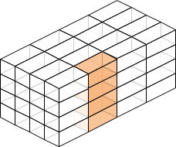
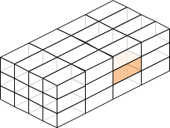
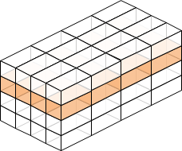
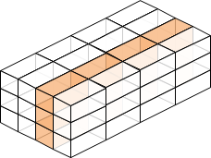
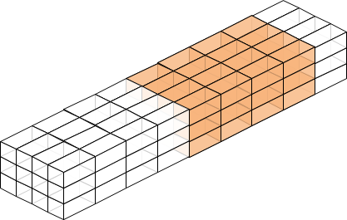
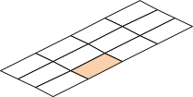
Everything is different and everything is the same
Block
Section
Stack
Slot
Block
Section, Bay, Yard Row
Stack, Pile
Slot
Tier
Row
Range
Ground slot
Tier
Column?
Range
Yard Stack

Slide 9
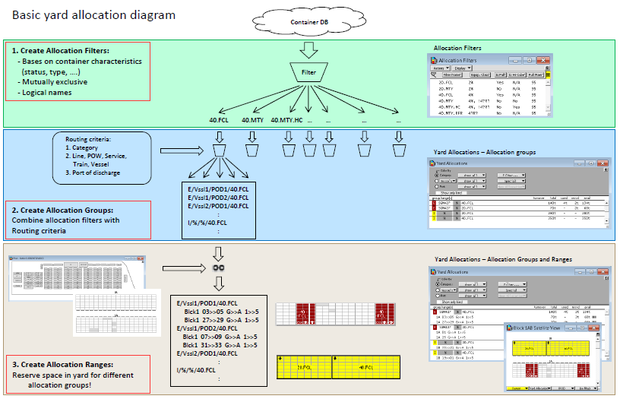
1 Record = numerous fields

Slide 10

The largest port complex still relys on paper products to share information. With this initiative of this project we have begun to put the power of information into the hands of the operators.

Slide 11
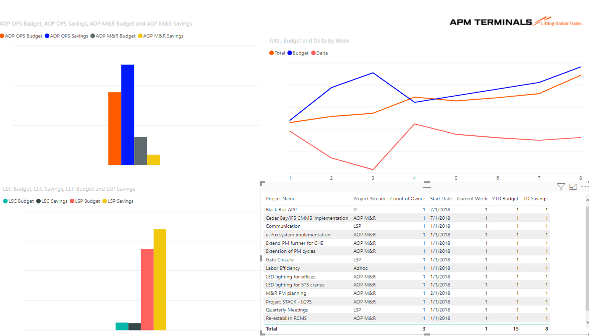
Project Management Incorporation

Slide 12
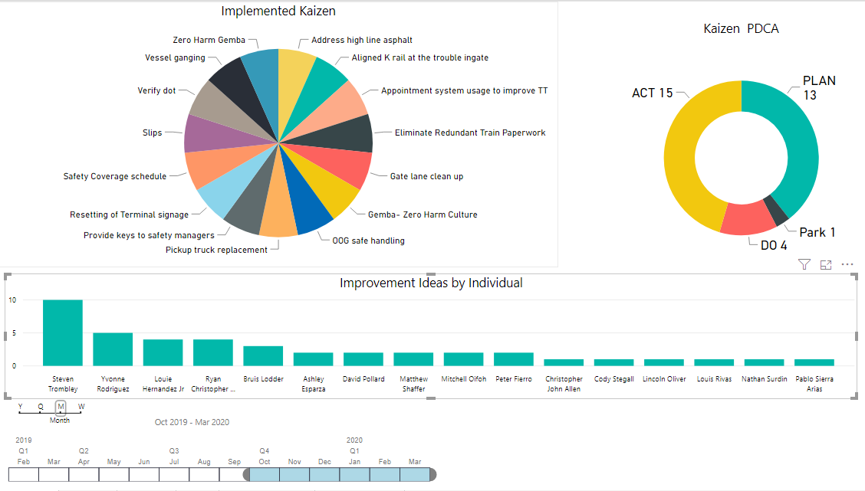
People Performance Management Tracking Imported from Power App

Slide 13
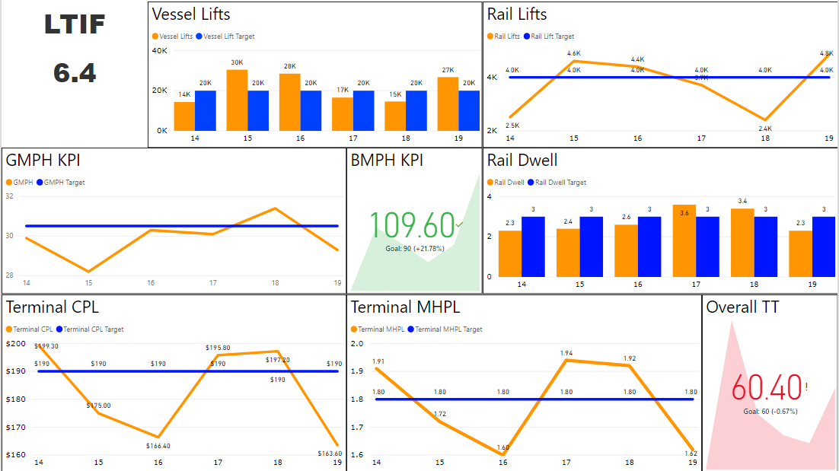
KPIs across entire organizational hierarchy now being monitored and reported real time

Slide 14
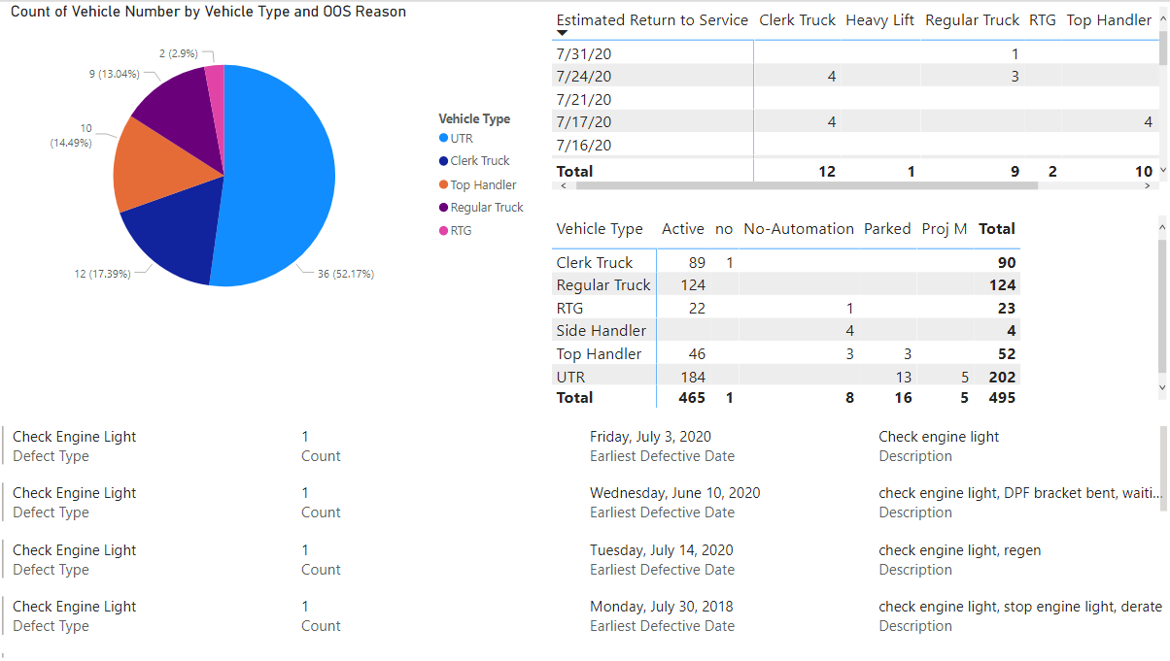
API Driven Realtime Equipment Status and Performance

Slide 15
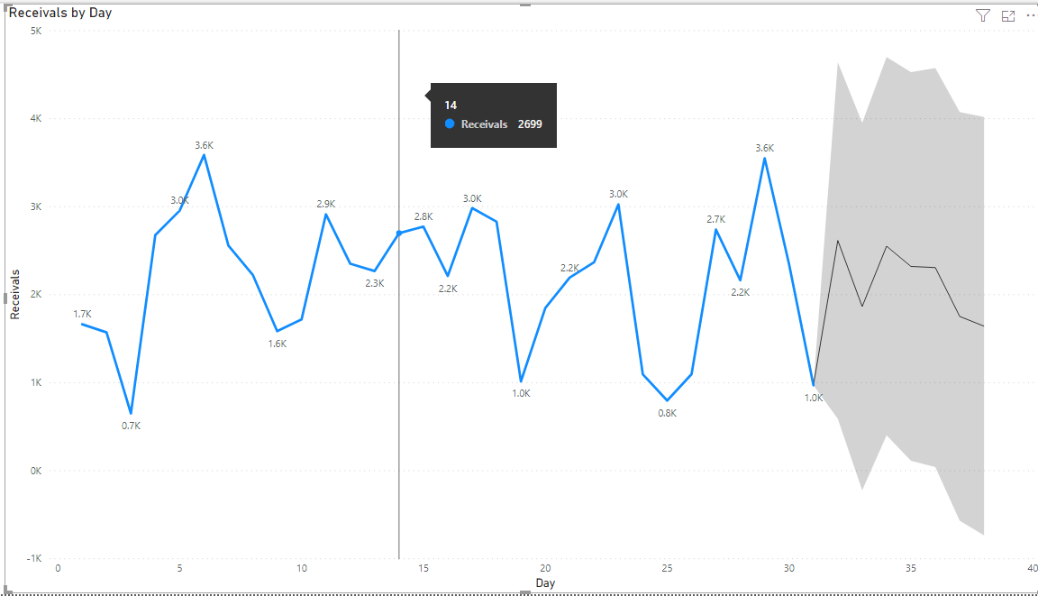
We have now started to use our machine learning to show the forecast and confidence levels.

Slide 16
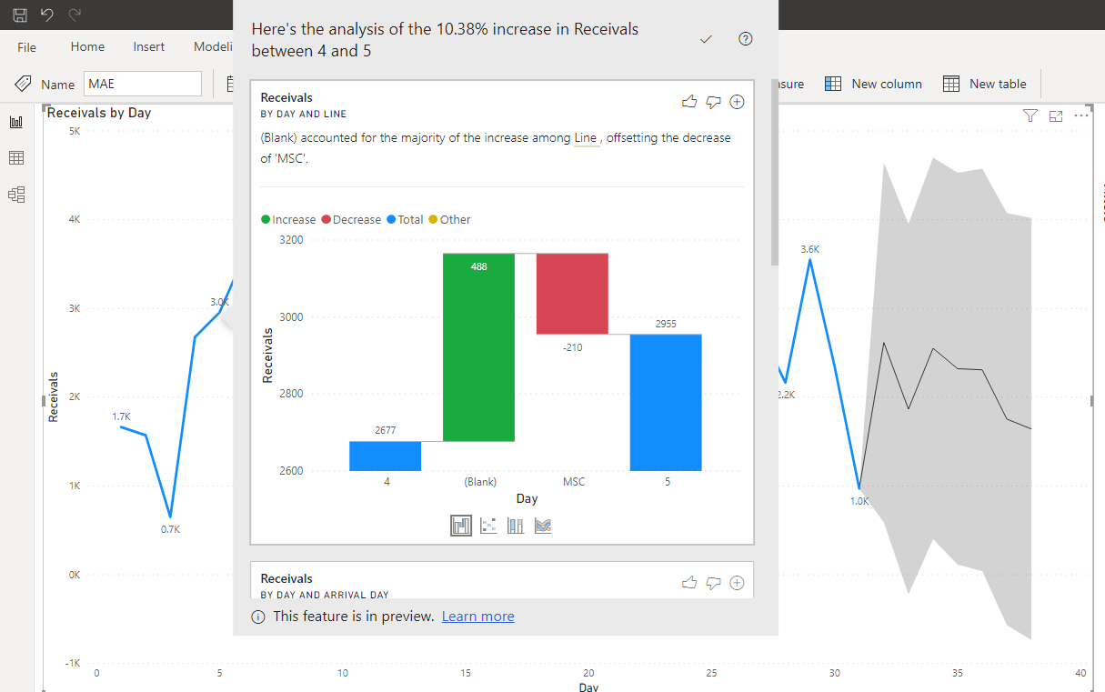
Which has brought the drill down functionality to another level

Slide 17
The End

